Slide 1
Conservation and Development of Ancestral /Indigenous Plant Genetic Resources: Challenges, Tools and Perspectives “Sharing the Canadian, Mexican and American Experiences"
“THE ROLE OF NATIVE INDIGENOUS COMMUNITIES OF MEXICO IN THE ACCESS OF GENETIC RESOURCES AND THE FAIR AND EQUITABLE BENEFIT SHARING"
Quebec City, QB. May 10th – 11th , 2016.

Slide 2
Article 1. Objectives:
The Convention of Biological Diversity (CBD)
To preserve the biological diversity
To promote the sustainable use of its components
To assure the fair and equitable sharing of the benefits derived from their utilization.
Released for signature in June, 1993
Enforced in December, 1993

Slide 3
Key elements in the preamble of CBD related to indigenous communities and genetic resources:
The Convention of Biological Diversity (CBD)
Conscious of the intrinsic value of biological diversity and of the ecological, genetic, social, economic, scientific, educational, cultural, recreational and aesthetic values of biological diversity and its components,
Reaffirming that States have sovereign rights over their own biological resources,
Recognizing the close and traditional dependence of many indigenous and local communities embodying traditional lifestyles on biological resources, and the desirability of sharing equitably benefits arising from the use of traditional knowledge, innovations and practices relevant to the conservation of biological diversity and the sustainable use of its components,

Slide 4
The Nagoya Protocol
At their 4th Conference of Parts ⁽COP) of CBD in 1998, A decision was taken to establish an experts panel to clarify principles and concepts related to ABS (Access and Benefit Sharing), establishing next year an Ad Hoc open-ended Working group on ABS.
The group developed in 2002 the Bonn Guidelines on ABS as a first instrument to assist parties on establishing measures on ABS issues.
The Ad Hoc open-ended working group meet 11 times from 2005 to 2010, giving birth in October, 2010 to the Nagoya Protocol (NP) at the 10th COP in Nagoya, Japan.
The NP was enforced in October 2014 as the 50th signatory ratified the instrument.

Slide 5
Indigenous people in Mexico
According to the Commision for The Development of Indigenous Peoples (CDI), 10.45% of Mexico’s population are indigenous people
6.6% of the of the Country’s population speak a pre-Hispanic language
11 Linguistic families
68 Languages
364 dialects
Inigenous peoples are distributed all around the Country, but with higher concentration in south-east Mexico
Living in mountainous, poorly developed regions, with a well-defined culture and identity, and closely related with the environment.
Rich tradition in in situ conservation and use of local genetic resources and their ancestral knowledge associated

Slide 6
Indigenous people in Mexico

Slide 7
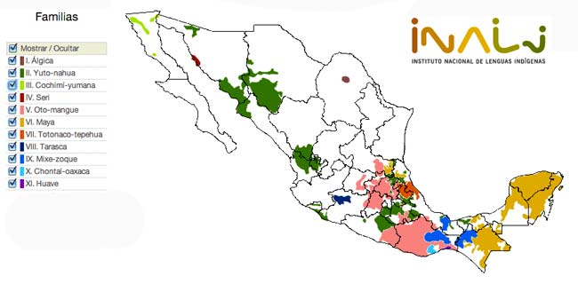
Pre-hispanic language families in Mexico

Slide 8
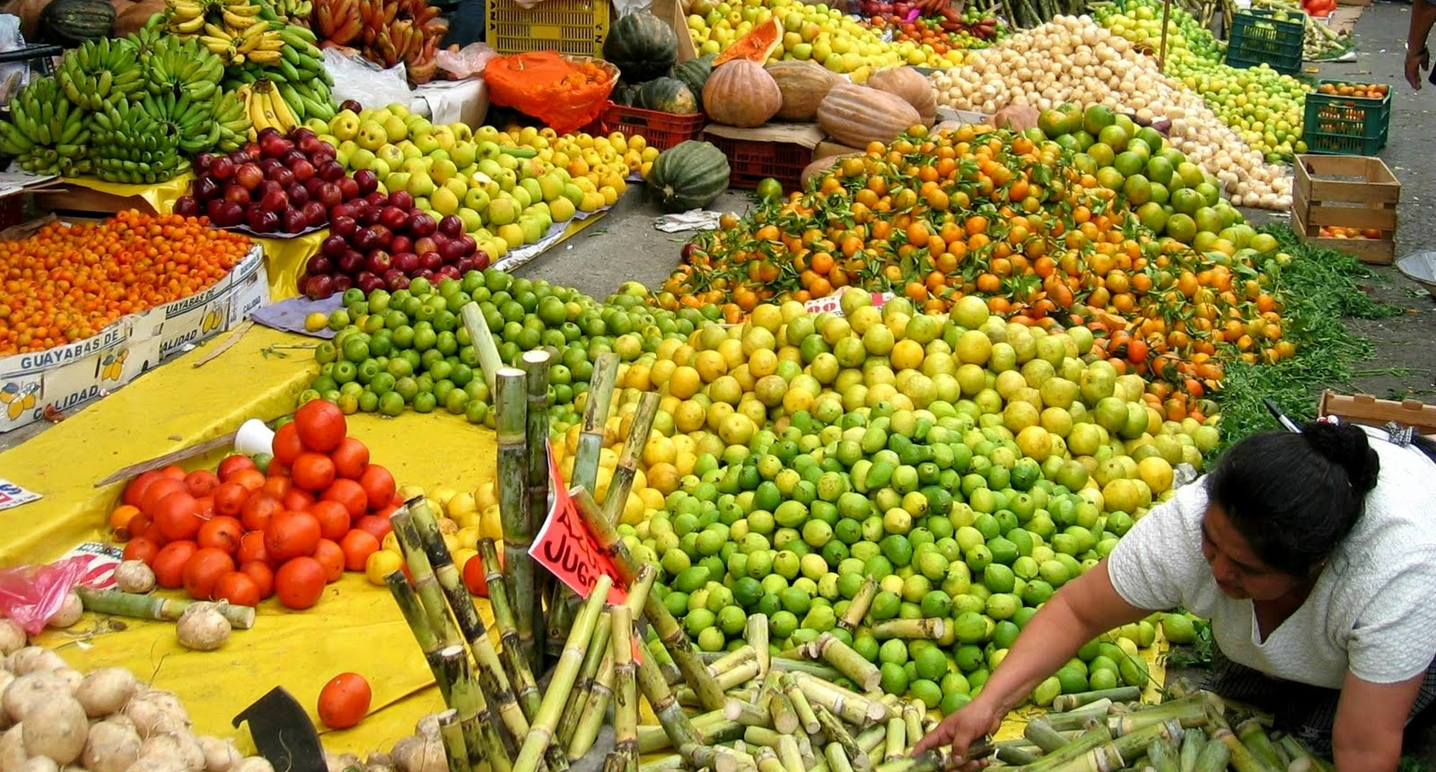
Indigenous people in Mexico…
In Mexico, more than 1200 plant species are used for food consumption and other human necessities, either domesticated or taken from the wild biodiversity (CONABIO).
Many of these species have limited and local actual use, but are promissory due to their resilience and potential use in climate change-related adverse environmental scenarios.

Slide 9
ABS and traditional knowledge
Our appreciation of genetic resources relays in great extent on the traditional knowledge of local and Indigenous Communities passed from generation to generation.
The importance of this knowledge has to be properly understood and valuated by the users.
Hence, the rights of Indigenous communities have to be taken in account when negotiating access and benefit sharing

Slide 10
ABS and traditional knowledge
Basic mechanisms to assure a fair and equitable ABS:
PIC and MAC
PIC: Previously Informed Consent. A permission given by the competent authorities of the Country, previous to the access and under the adequate institutional and legal framework.
MAC: Mutually Agreed Conditions: Agreement between providers and users related with the general and specific conditions for access and use and the benefits to be distributed among both parties.

Slide 11
Who participate in ABS as providers and Users of GR
Providers:
The states, which are sovereign over their natural resources.
Owners and local and indigenous communities
Facilitators:
The law and the enforcer

Slide 12
Who participate in ABS as providers and Users of GR
Users:
Botanical gardens, Research Institutes, Researchers, Industry (pharmaceutical, cosmetic or agriculture).
Facititated by:
National Focal Point
National competent authorities

Slide 13
Consultation to the Indigenous Communities
:
It´s a right guaranteed by the National Constitution
Gives the elements to determine if, under their own criteria, their rights and subsistence are affected
They must be carried out following the traditional uses and procedures of each community
The consultations are done under the supervisión of the Federal Government

Slide 14
Access modalities
:
Facilitated access
For Research, taxonomy, collection, pre-breeding purposes
Consultation can be done through the IC representatives
Complete Access
When a comercial use and profits are envisioned
It can be first or second intention
A consultation to the community has to be done
Terms for the MAC have to be agreed

Slide 15
Consultation to the Indigenous Communities
:
Preliminary agreements (5-6 d)
Informative phase (21 d)
Deliberative phase (39 d)
Meeting of final agreement (PIC signature)

Slide 16
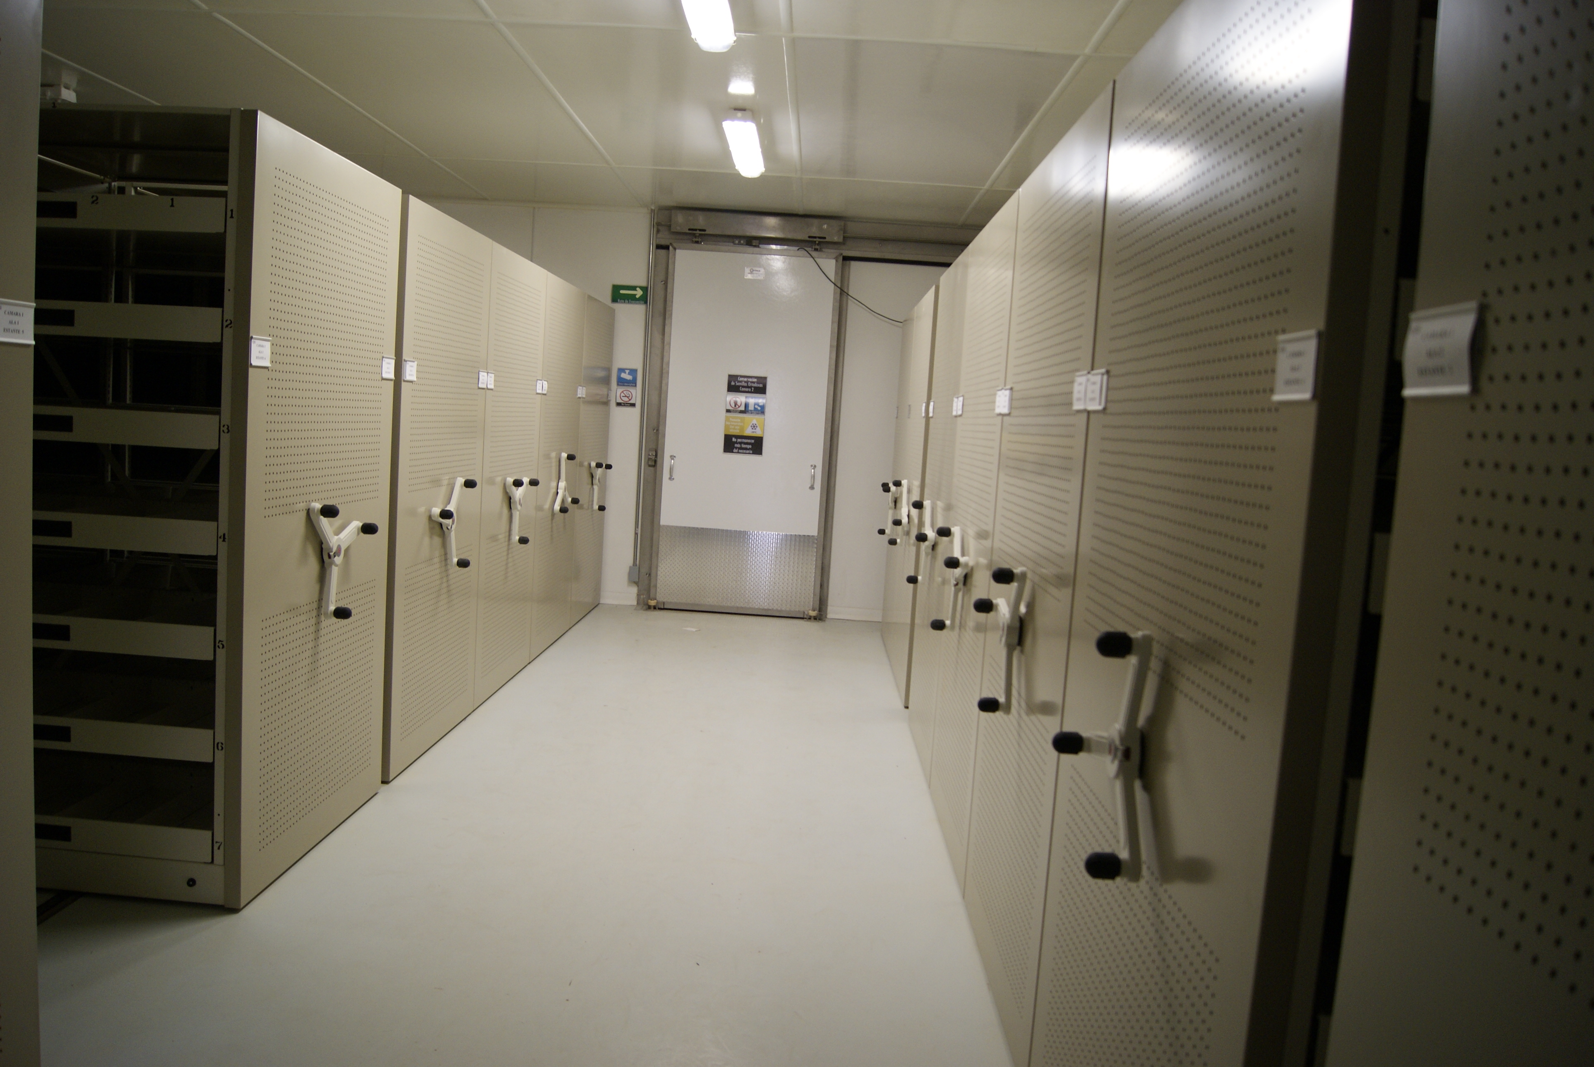
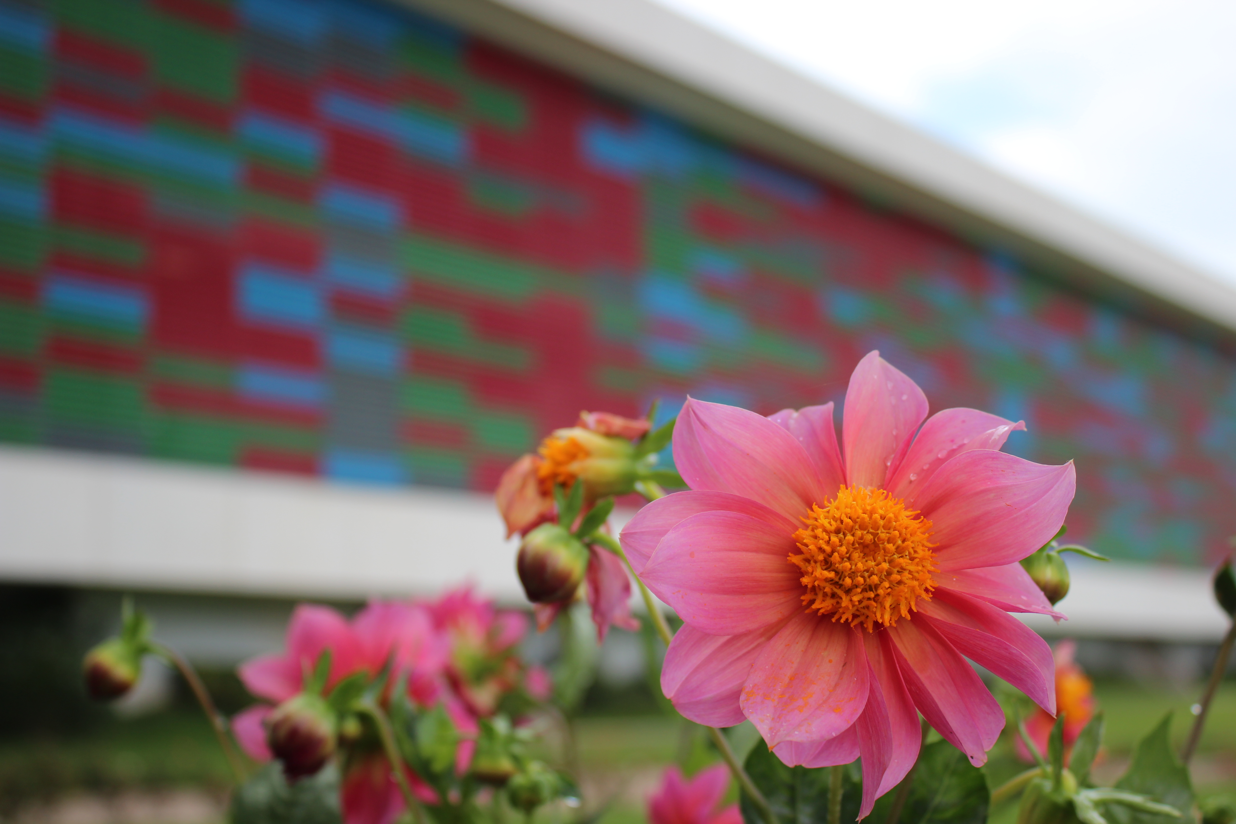
Mission
National Genetic Resources Center of Mexico
To ensure the conservation of the genetic resources present in Mexico with economic, social and environmental value, in order to contribute to their equitable and sustainable use, for the benefit of the present and future generations, supported by scientific knowledge and cutting edge technologies

Slide 17
CNRG main features and goals
National and multi-institutional initiative.
Composed of five conservation/research areas (crops, forestry, animal, aquatic and microbial GR)
Focused on long term conservation, for either Mexican or exotic species of population’s interest.
Linked to national and international germplasm banks.
Research projects collaborations.
Databases compatible worldwide.
National and international germplasm exchanging coordination.

Slide 18
CNRG Laboratories
DNA & Genomics
Microorganisms
Crops/Forest
Aquatic/Livestock
Main Building:
Conservation Areas
Laboratories
Offices

Slide 19
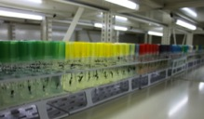
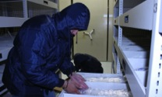
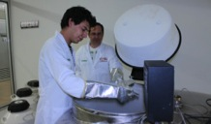
Current preservation capabilities
Sample | Preservation method | Subsystem*
Seeds | Cold chambers (-20°C) | Ag, F
Plant tissues and plants** | Cold chambers (15 a 4°C) Liquid Nitrogen (-196°C) | Ag, F, M
Semen | Liquid Nitrogen (-196°C) | Ac, P
Oocytes | Liquid Nitrogen (-196°C) | Ac, P
Embryos | Liquid Nitrogen (-196°C) | Ac, P
Larvae | Liquid Nitrogen (-196°C) | Ac, P
Cells | Liquid Nitrogen (-196°C) | Ac, P, M
Microbial strains | Liquid Nitrogen (-196°C) Ultra-freezers (- 80°C) | M
Nucleic acids | Liquid Nitrogen (-196°C) Ultra-freezers (- 80°C) | All
* Ac= Aquatic; Ag= Crop plants; F= Forest plants; M= Microbial; P= Livestock
**Includes plants, plantlets, meristems and other in vitro propagated plant tissues

Slide 20
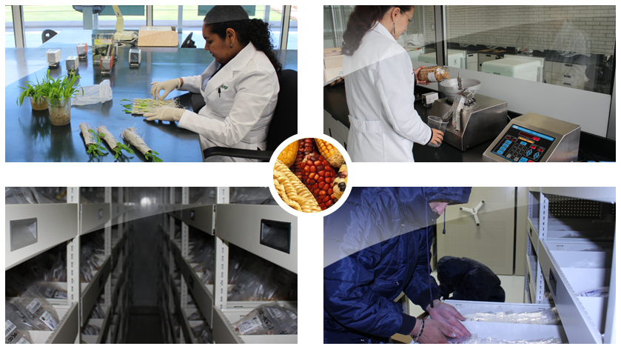
Orthodox seeds inventory: 24,216 accessions (23400 are crops)

Slide 21
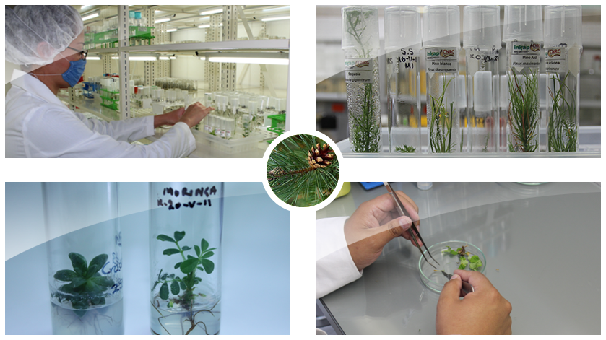
in vitro propagated plant tissues,418 accessions (11,043 plants in test tubes)

Slide 22
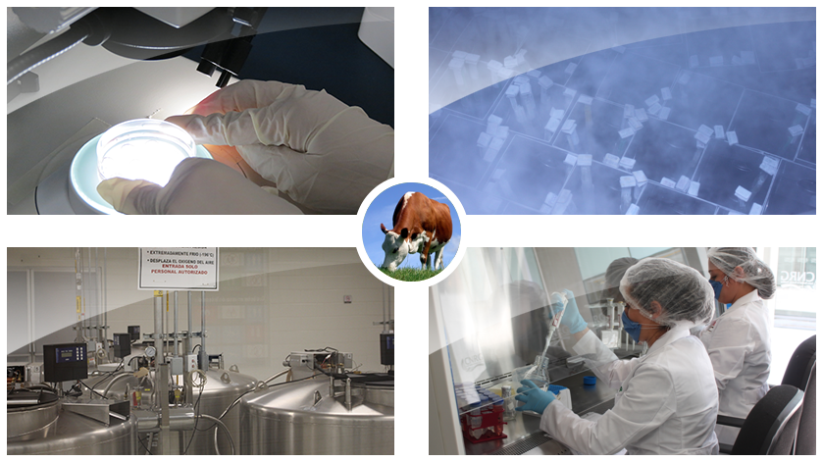
Livestock germplasm (26,950 straws) Aquatic germplasm (2,079 straws)

Slide 23
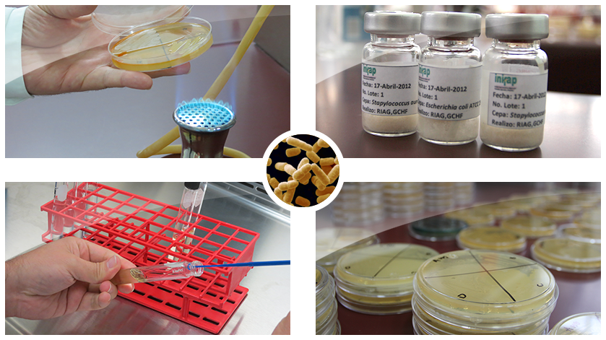
Microbial genetic resources (1800 strains)
Reference strains
Fungi and bacteria for biological control
Lactobacillus used on cheese industry.
Eatable fungi
Microalgae

Slide 24
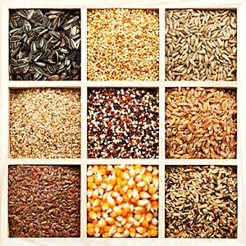
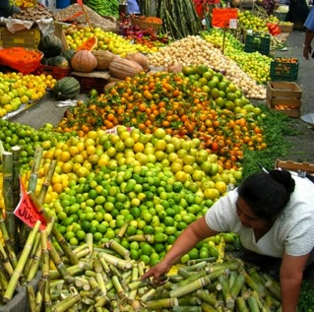
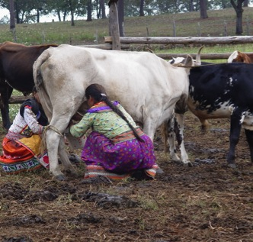
Thank you very much for your attention
inifap.gob.mx

